Slide 1

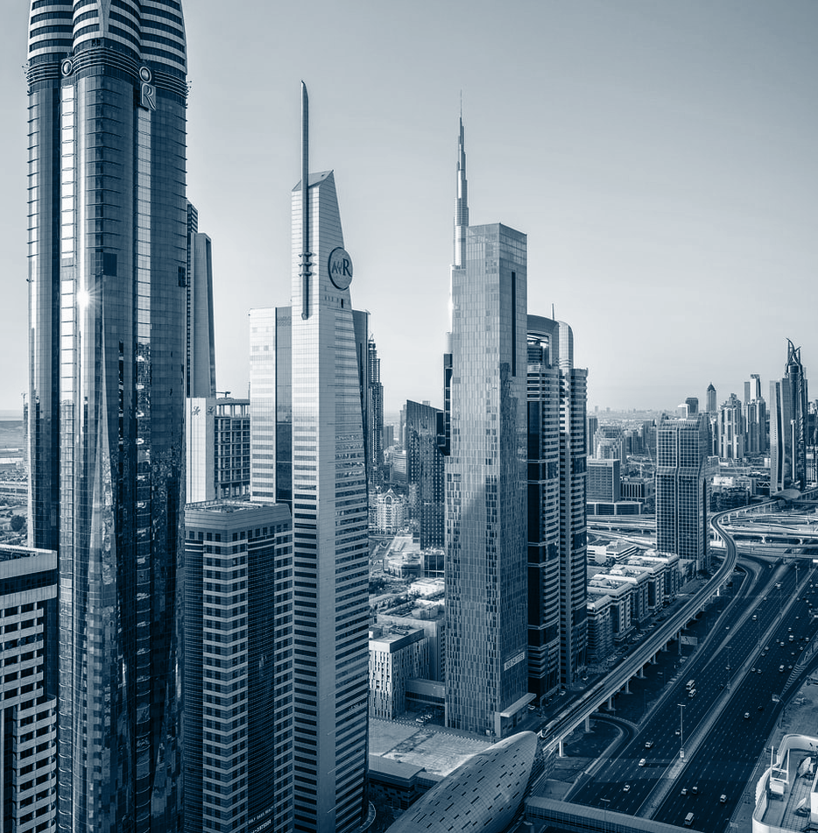
Travel Experts’ Web Application

Slide 2
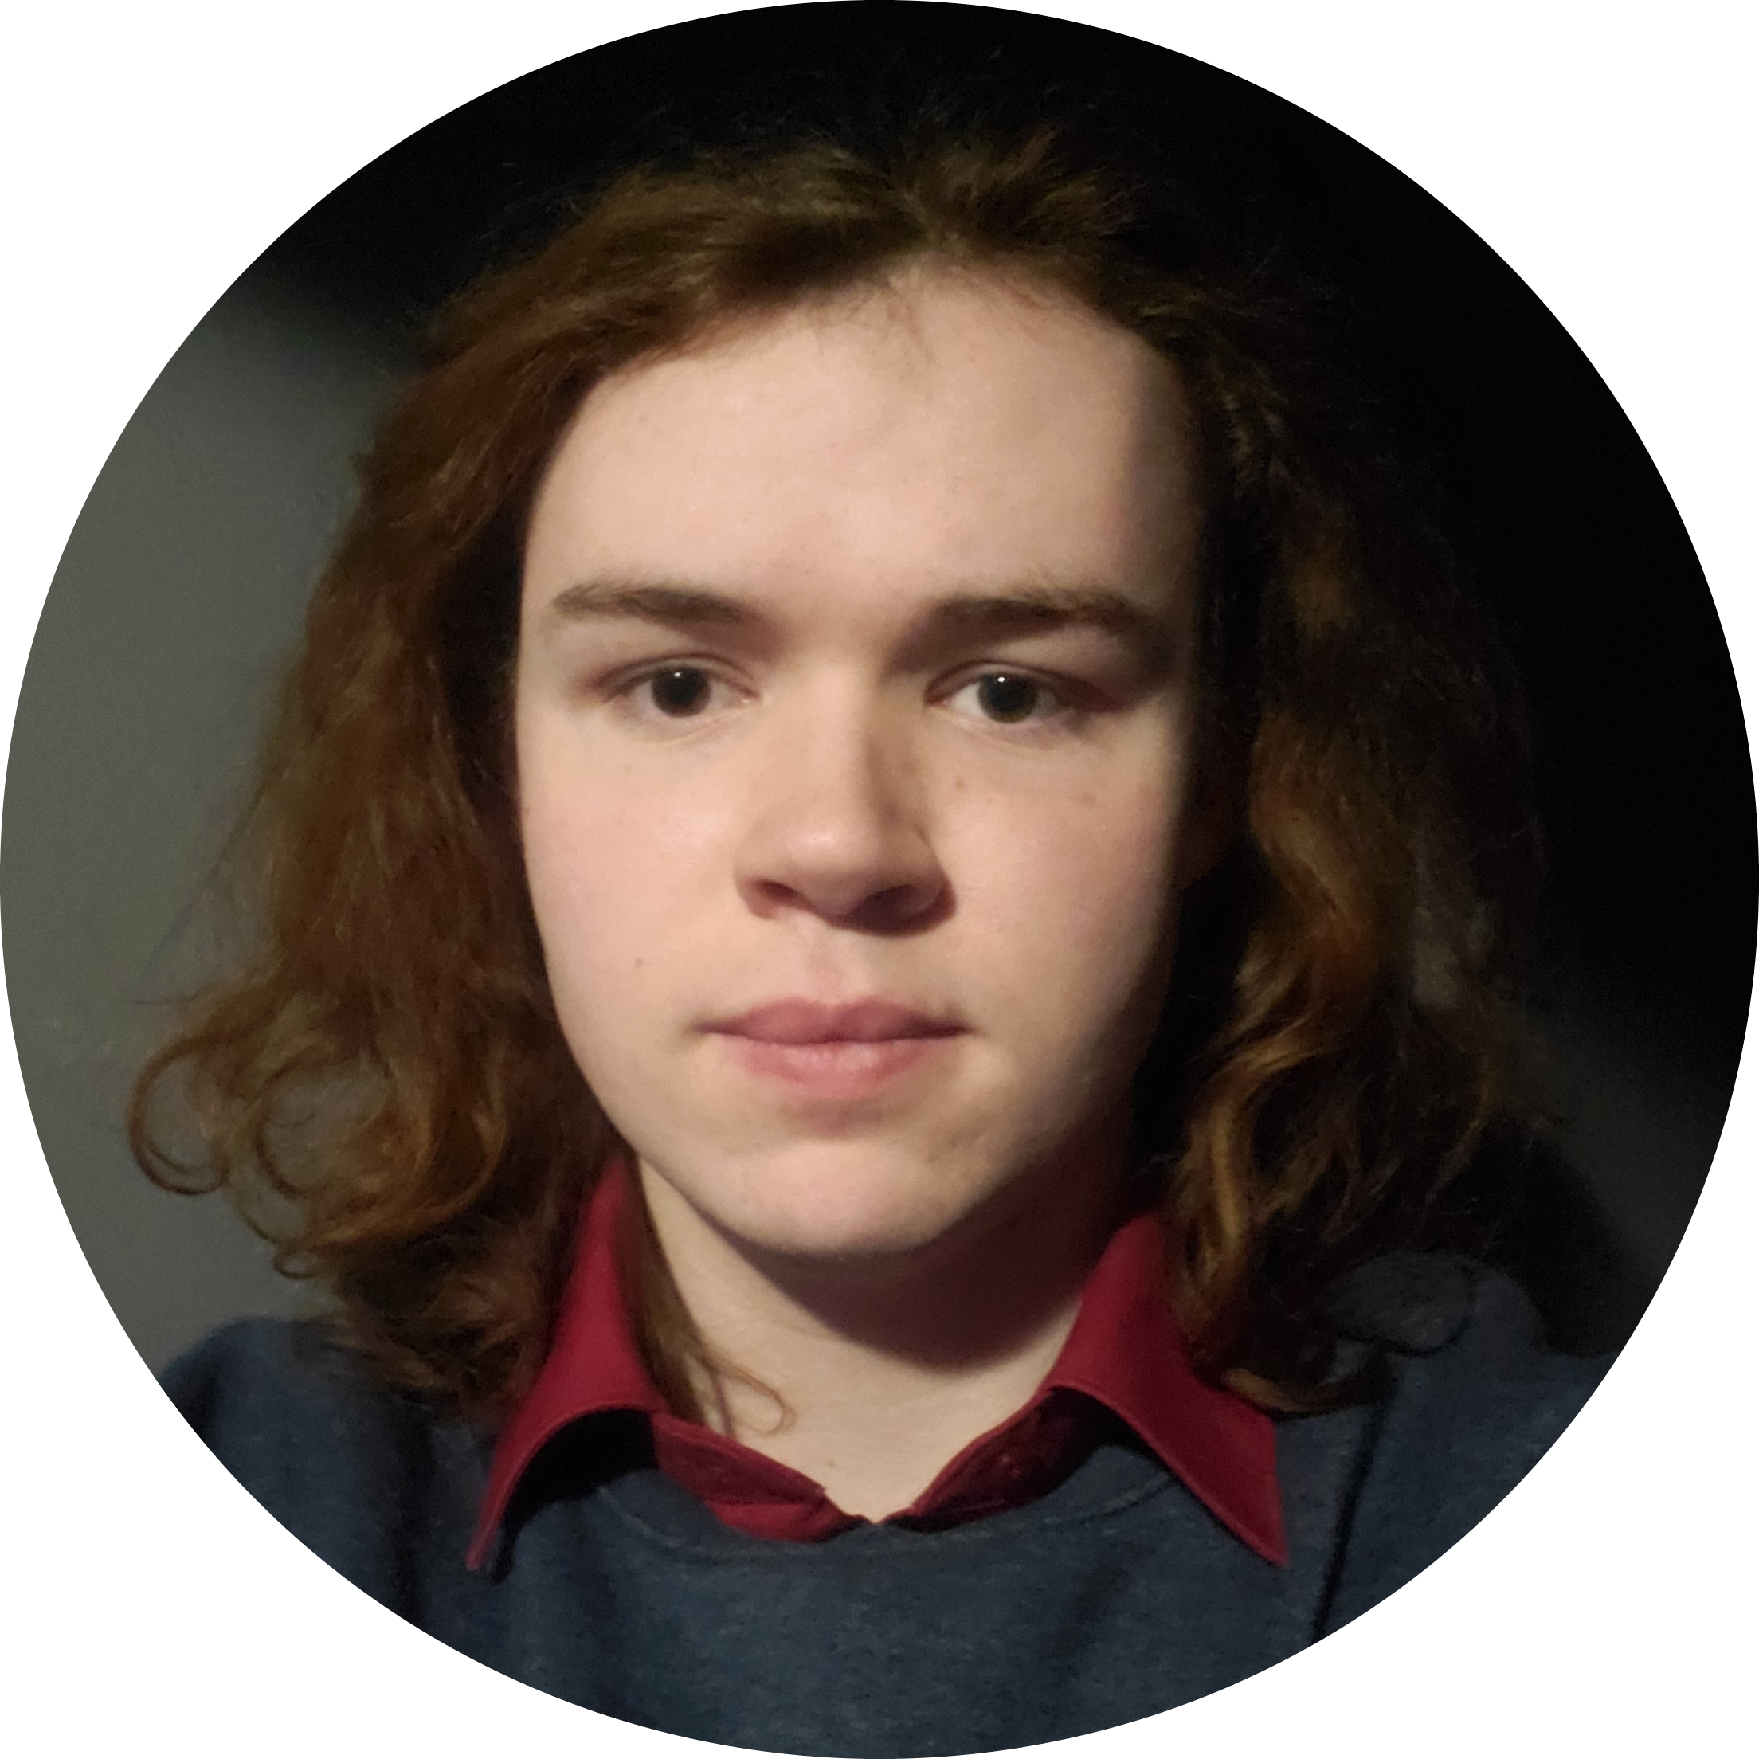

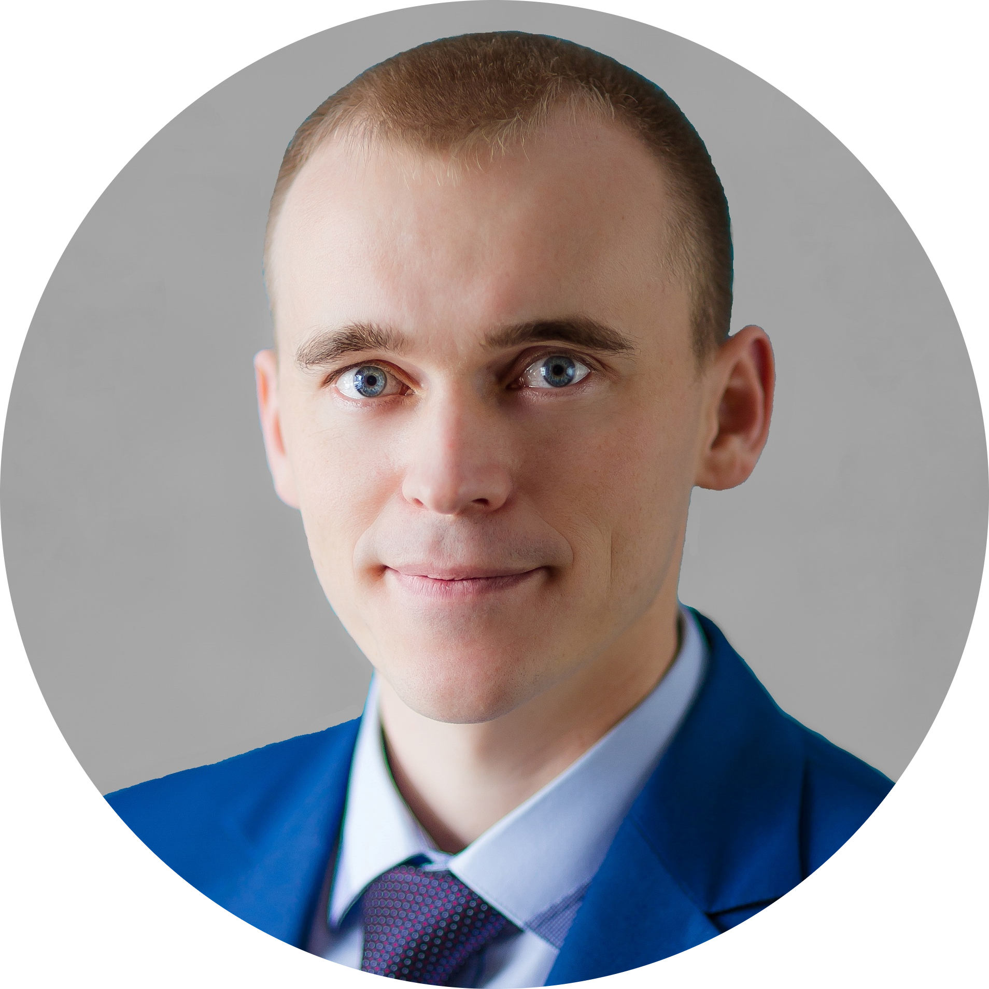
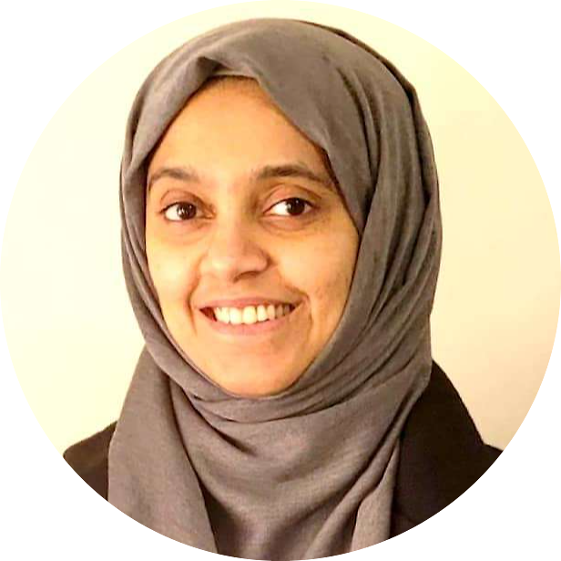
GROUP 5 Team
Daniel Palmer SOFTWARE DEVELOPER
Backend Wizard
Justin Molnar SOFTWARE DEVELOPER
Frontend Magician
Marat Nikitin SOFTWARE DEVELOPER
Documentation Sorcerer
Shifa Malik SOFTWARE DEVELOPER
Creativity Muse

Slide 3
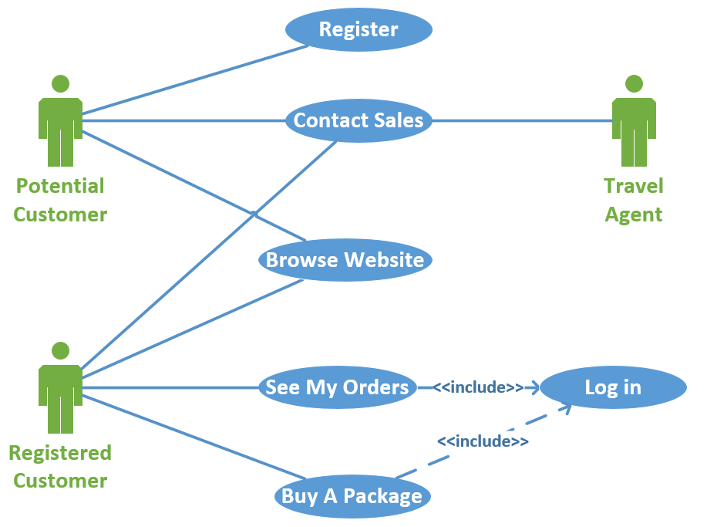
Current prototype’s Use Case Diagram

Slide 4

Travel Experts’ Website Demonstration
4

Slide 5
Our proposal
C$149K *
* Based on specifications in the Travel Experts’ request for proposal (RFP)

Slide 6

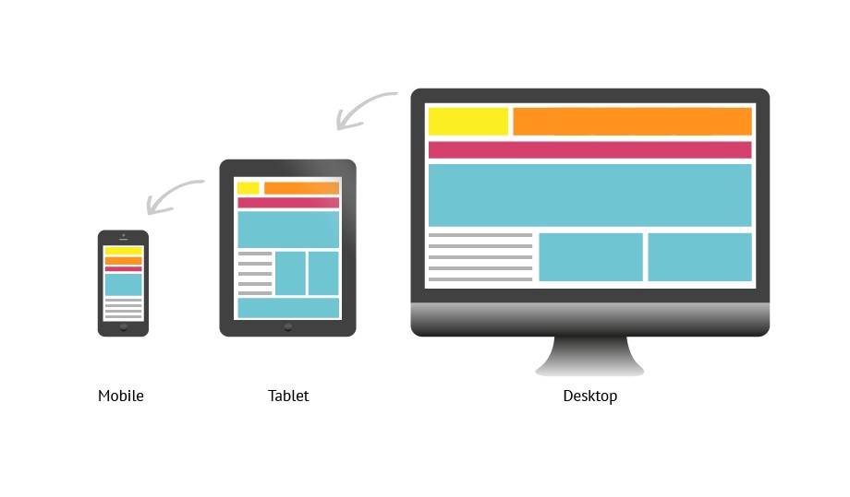

Hidden advantages of the prototype
SEO optimized, fast & dynamically generated content
Responsive design implemented
Form data validations used

Slide 7
Extra upgrading ideas
Sitewide sign-in
Enhanced site security & e-mail verification
Easily customizable through desktop app

Slide 8

Thank you!
Questions?
Suggestions?
contactus@groupfivedevelopers.ca
+1 (403) 55-GROUP-5
8

